Slide 1


Spring 2020
SKKU Advanced fMRI analysis 2
CHOONG-WAN WOO | COCOAN lab | http://cocoanlab.github.io

Slide 2
Advanced fMRI analysis 2 | Spring 2020
Lecture 01 | 031320
Lecture 01
Class overview + planning
CHOONG-WAN WOO | COCOAN lab | http://cocoanlab.github.io

Slide 3
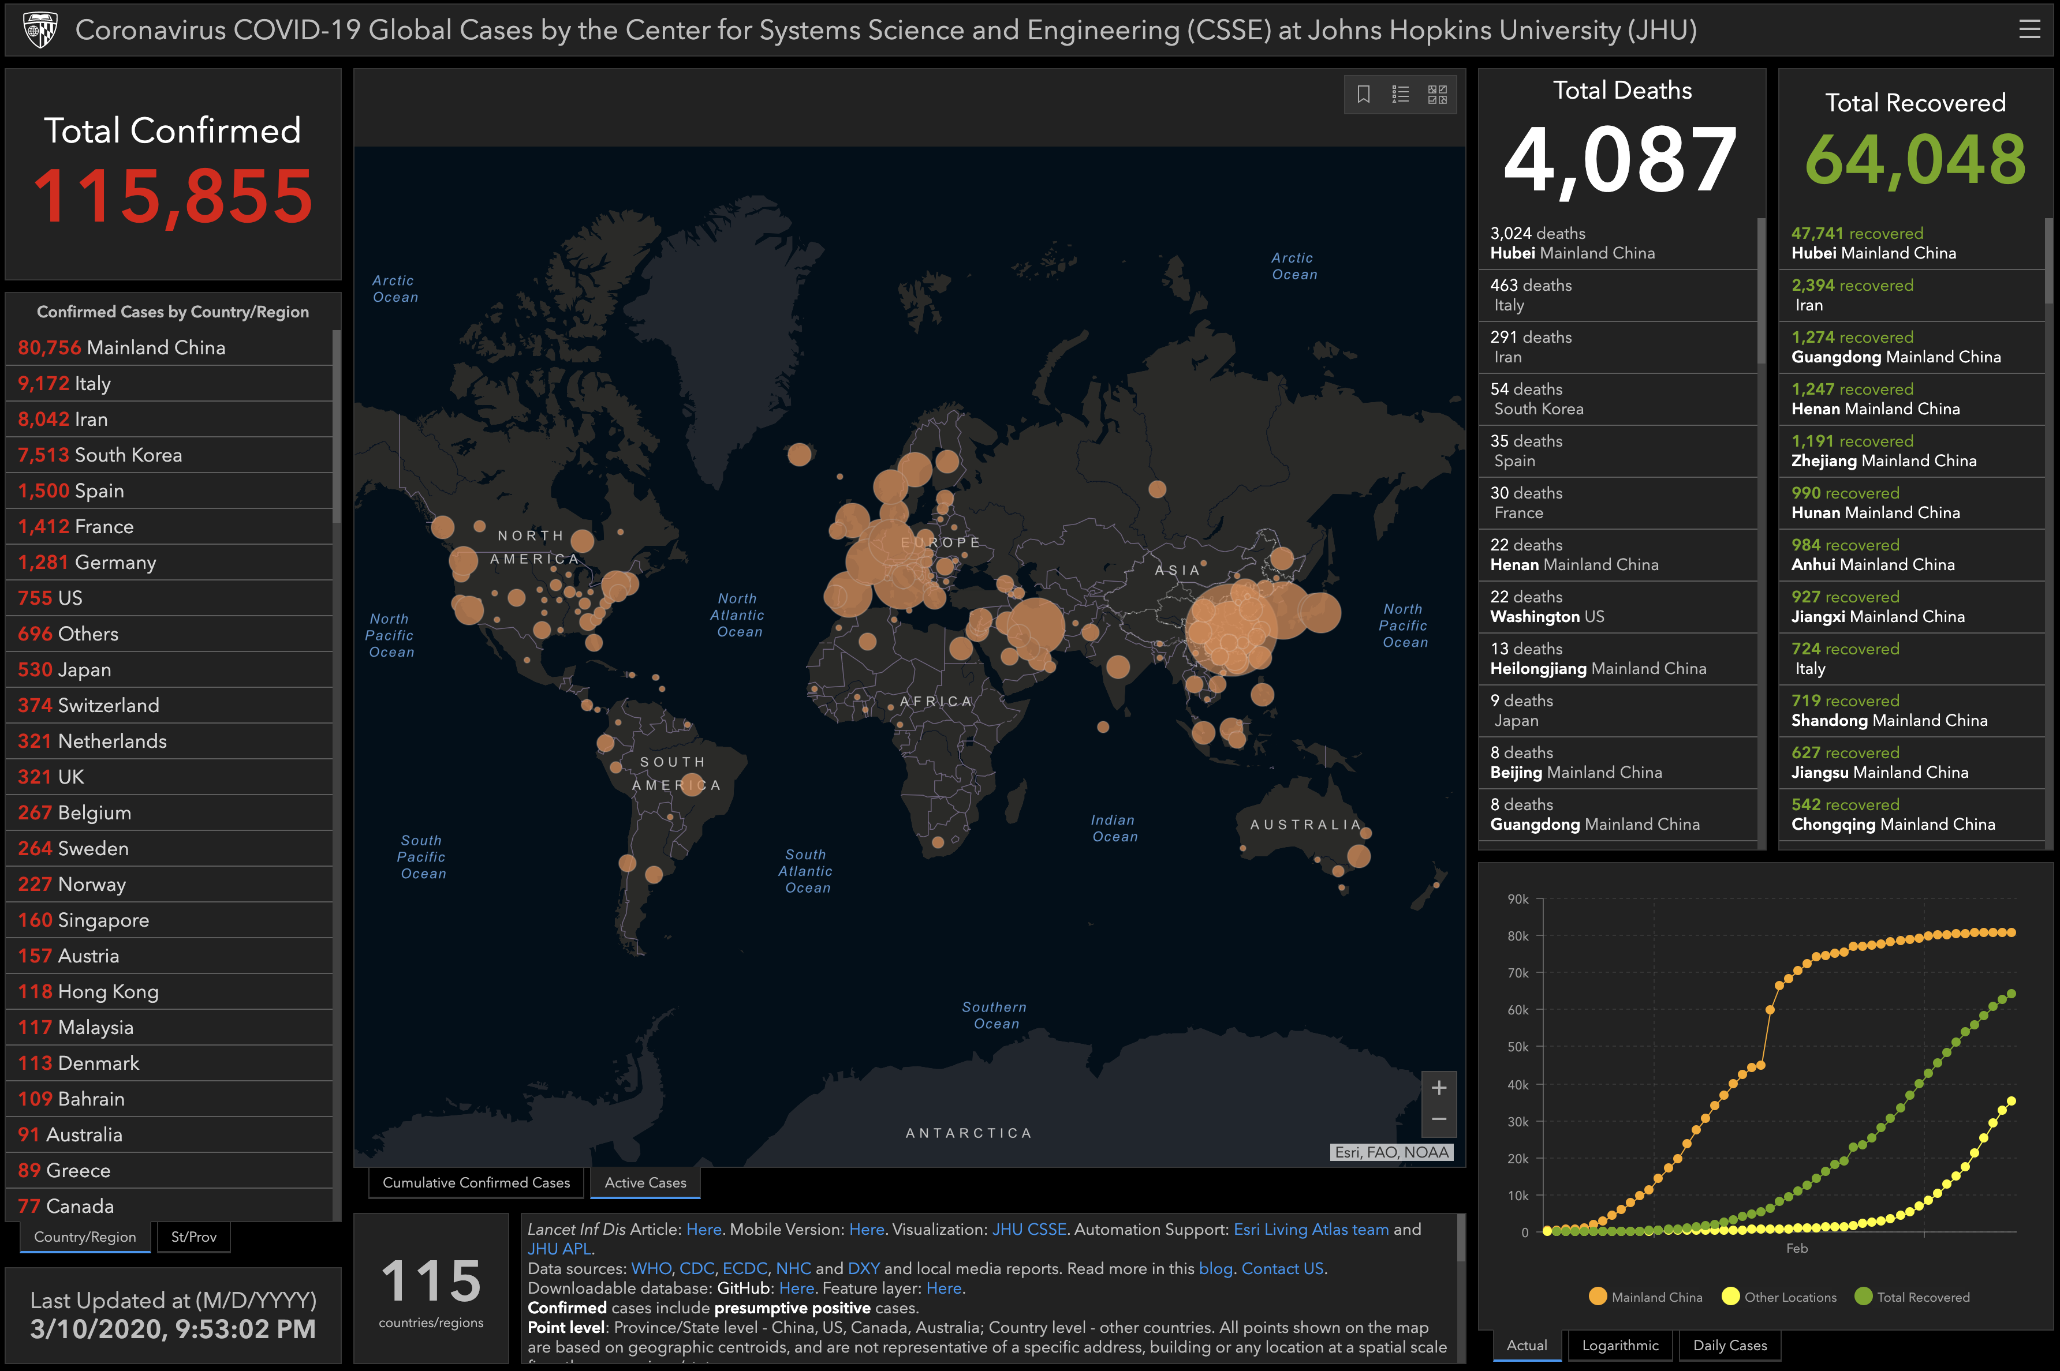
COVID 19 pandemic
https://www.arcgis.com/apps/opsdashboard/index.html#/bda7594740fd40299423467b48e9ecf6
CHOONG-WAN WOO | COCOAN lab | http://cocoanlab.github.io

Slide 4
Like classes
CHOONG-WAN WOO | COCOAN lab | http://cocoanlab.github.io

Slide 5


Why I’m trying this live-streaming
But.. most of the classes were not ready for this.. because most of the classes have been designed as the offline ones.
Our class is especially made for hands-on experience and making tutorials, so we’re kind of in trouble!!
What makes it more difficult is that we cannot really predict until when the COVID-19 will be a problem.
I thought a lot about how to proceed with the class, and still not sure.
But I came to conclusion that we should be ready for the longer delay in having offline classes, and still want to learn things.
I thought live-streaming might be a good medium, and so I’m trying.
To succeed with this crisis, we really really really need your help and voluntary commitment.
Online
classes
CHOONG-WAN WOO | COCOAN lab | http://cocoanlab.github.io

Slide 6
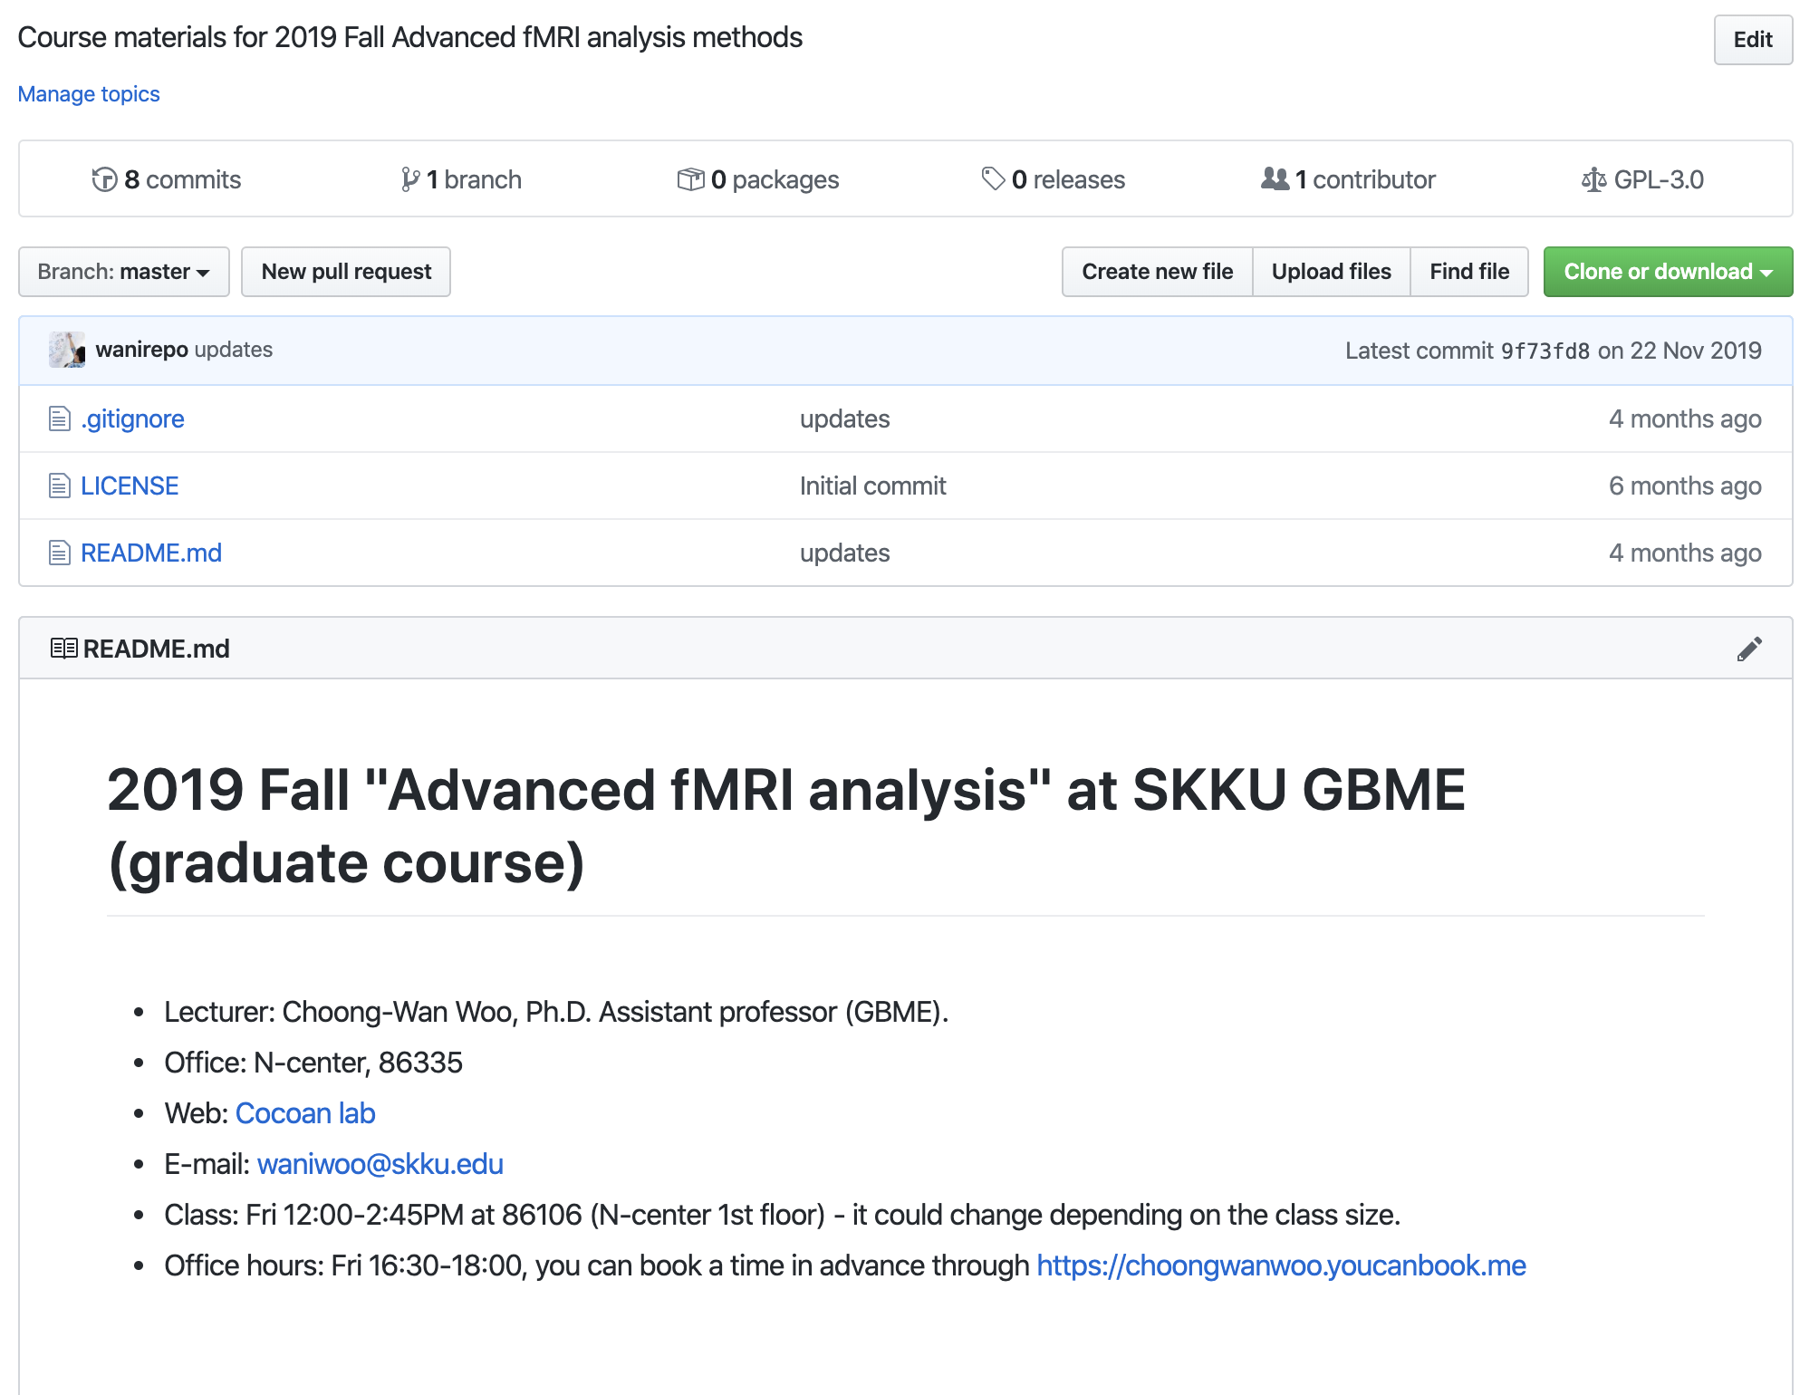
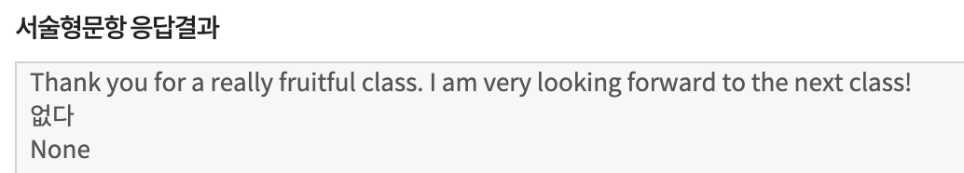
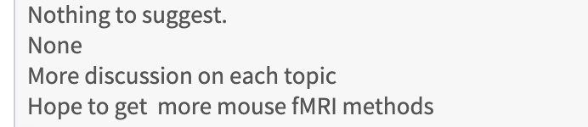
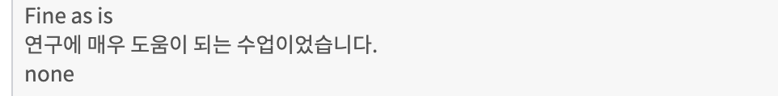
About this class
We already did the first advanced fMRI analysis course last semester, and the feedback was quite good.
This semester, we’ve got many students from outside of the department or even outside of the school.
CHOONG-WAN WOO | COCOAN lab | http://cocoanlab.github.io

Slide 7
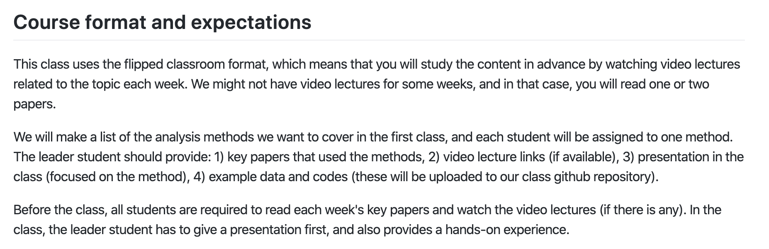
The class format (in the last semester)
CHOONG-WAN WOO | COCOAN lab | http://cocoanlab.github.io

Slide 8
The class format (in the last semester)
In the first class: Teamed up and assigned to specific methods
2nd – 3rd classes: To give you some time, Suhwan and Lada gave tutorials (as an example)
4th – the end: each team
Introduced a method
Provided the detailed background of the method
Provided the analysis tutorial
and tried it together
CHOONG-WAN WOO | COCOAN lab | http://cocoanlab.github.io

Slide 9
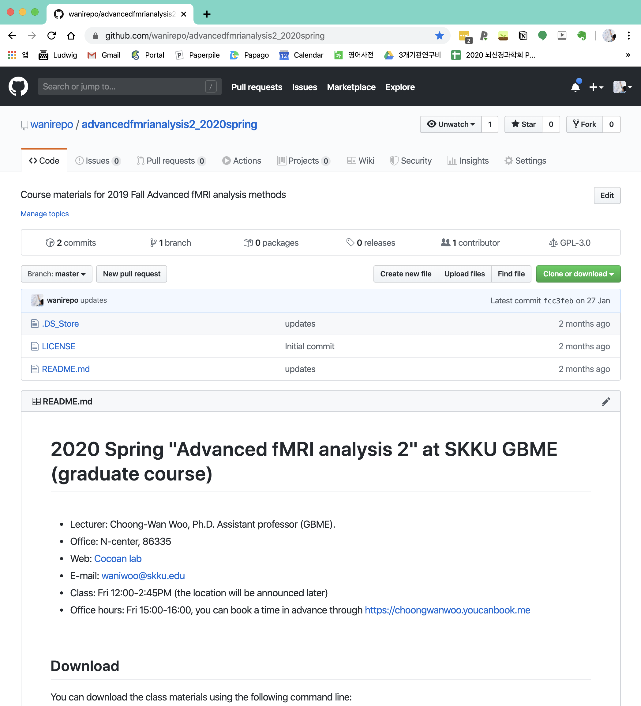
Let’s take a look at the class syllabus (on github)
https://github.com/wanirepo/advancedfmrianalysis2_2020spring
CHOONG-WAN WOO | COCOAN lab | http://cocoanlab.github.io

Slide 10
How I’d like to proceed this semester
In the first class (today; 3/13):
Let’s talk about the methods we want to cover
After we make a decision about the methods (~10 methods through survey), I will post a poll on slack (on 3/20)
Each of you should vote for “one” option (on a first-come-first-served basis)
We have around 40 people in this semester, so four people in one team will be reasonable.
But there is one consideration
Each student has a different level of expertise in fMRI analysis
Some are new in this field, and some are already doing a lot of fMRI research.
The ideal composition of the team will be
1-2 experts - role: making tutorial using example data
2-3 novices - role: preparing presentations about the background (e.g., mathematical background, hands-on calculation of the methods)
After we got the teams, I will examine whether the team composition really makes sense, and please understand if I ask you to change the team. But I will try not to.
CHOONG-WAN WOO | COCOAN lab | http://cocoanlab.github.io

Slide 11
How I’d like to proceed this semester
In the 2nd ~ 3rd weeks (3/20-27)
I will give presentations
One week for introducing our CANlab tools and also the mediation analysis
The other week for the fMRI data visualization
If you want to help with these two weeks’ presentations (e.g., I give the background, and you give the tutorials, similar to what Suhwan and Lada did last semester), please let me know. You won’t need to do the other tutorials for later weeks. ☺_
CHOONG-WAN WOO | COCOAN lab | http://cocoanlab.github.io

Slide 12
How I’d like to proceed this semester
In the 4th ~ the end (4/3-6/19)
We have 12 weeks.. Except for the midterm/final weeks, we will have 10 weeks
The team comes to the small conference room in the N-center and will do the livestream class with me.
The structure will be similar:
Introduce the method
Provide the detailed background of the method
Provide the analysis tutorial
But “try it together” might be difficult. For this, until the class is online, we cannot really try the methods together, but you can do it at home or at your desk. If you have any trouble in setting and running, please post questions on slack.
CHOONG-WAN WOO | COCOAN lab | http://cocoanlab.github.io

Slide 13
Important considerations
No free lunch!
Each of you must contribute to the class!
Participation and contribution will be the most important factor for grading.
Even those who are sitting in, you should contribute.
If you don’t think you can, please drop the class or leave the class. OKAY?
But think about it.. It’s only one week for the entire semester. ☺
And also I’m confident that you will learn many things from the class (like the last semester) and so you also have to give something! ☺
Don’t worry even if you don’t know what to do.. I will be with you along the way ☺
CHOONG-WAN WOO | COCOAN lab | http://cocoanlab.github.io

Slide 14
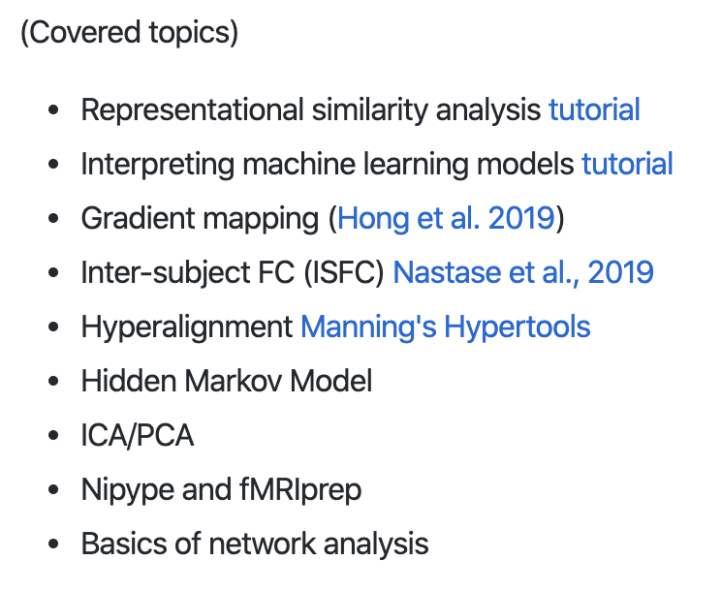
Topics
Last semester
CHOONG-WAN WOO | COCOAN lab | http://cocoanlab.github.io

Slide 15
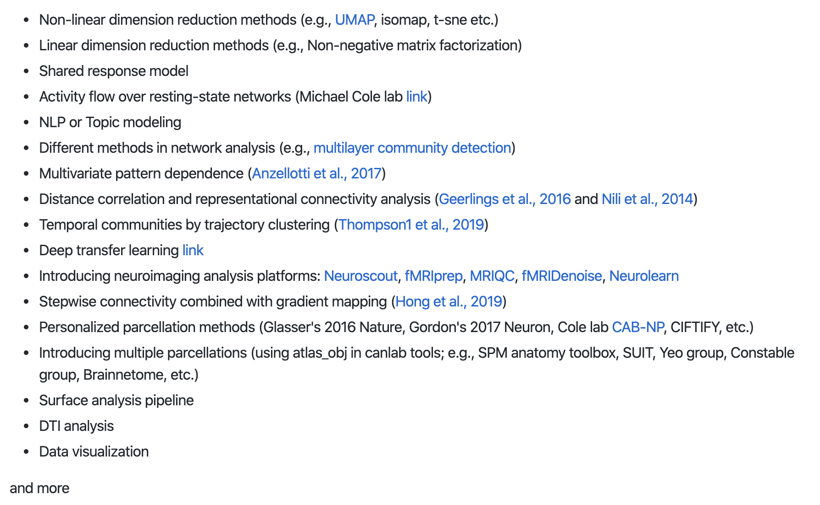
Topics
This semester?
CHOONG-WAN WOO | COCOAN lab | http://cocoanlab.github.io

Slide 16
Topics
This semester?
Topic survey
https://forms.gle/ayRTPBP2HG3skMjDA
Please submit your response before 3/19 (Tuesday) midnight.
Let’s make a vote starting 3/20 12PM (when the next class starts)
CHOONG-WAN WOO | COCOAN lab | http://cocoanlab.github.io

